Slide 1
Changing IP address on IB-E03BP (PNP) OR IB-E03BN (NPN) 2 Zone Controller (4 Amp)
By Donnie Smith

Slide 2
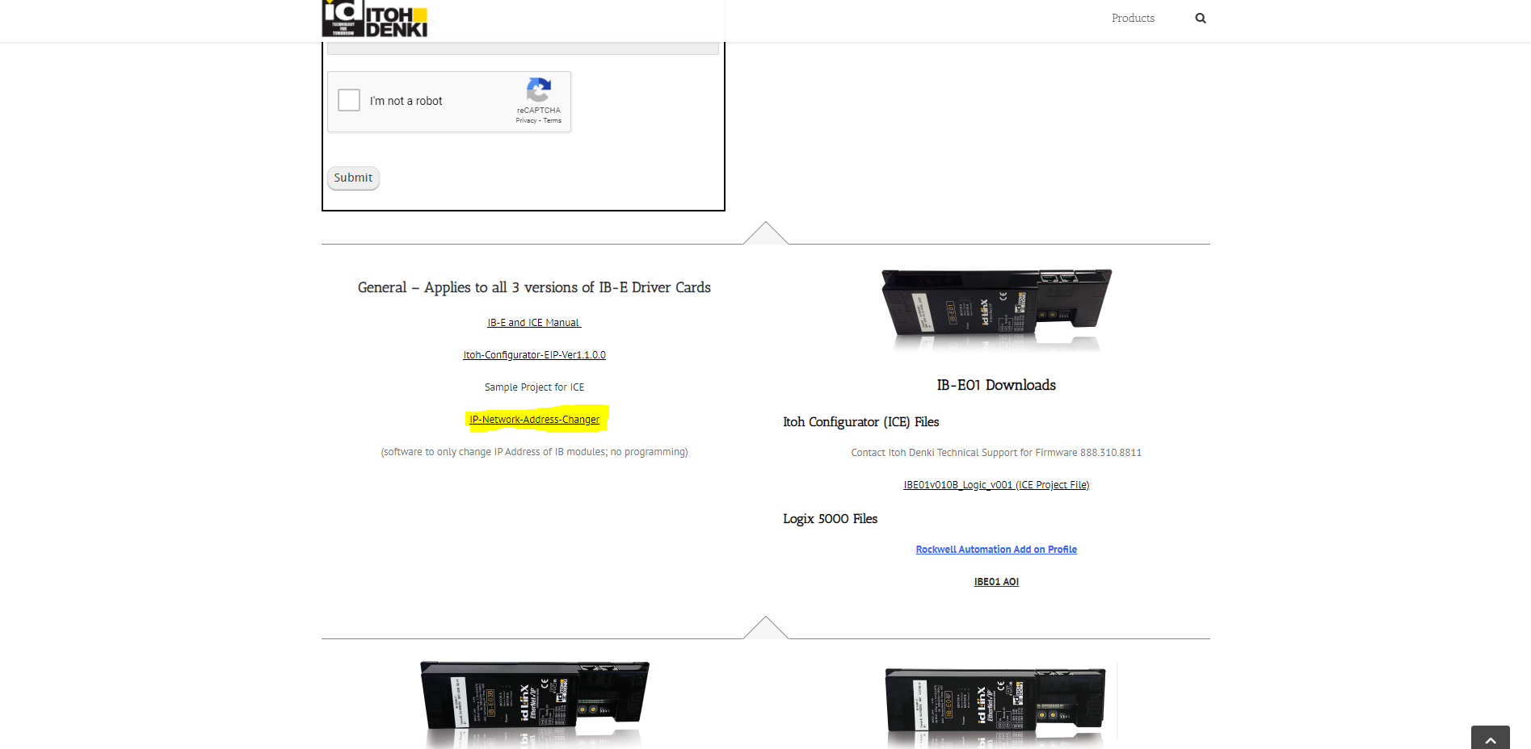
Downloading Software
http://itohdenki.com/ib-e-downloads

Slide 3
Manual

Slide 4
Isolate the Device
We found that you have to unplug everything from the device and only have power coming in and plug into Lan1

Slide 5
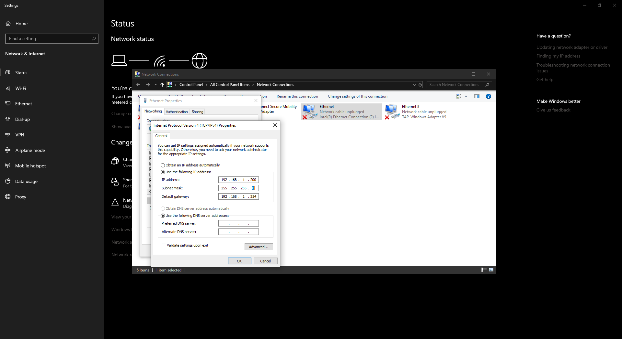
Have to change IP to read factor set card.
The Factor IP address is: 192.168.0.XXX
Subnet: 255.255.255.000
Gateway: 192.168.0.1

Slide 6
Launching Program
Open up the program and click discover.
There should pop up your IP address from your computer.
After that you should be able to go to select network and select your IP address.
After that you should see the IP address green, If not check your IP address again and or connection.

Slide 7
Changing IP address
On top where it says before network is the current IP address on the card.
Next to it after network is what and how we change it.
Arsaw station IP addresses are
IP address: 11.200.1.XXX
Subnet: 255.255.252.000
Gateway: 11.200.1.1
After that you hit write and yes I want to make changes.

Slide 8
Changing IP address Continue…
After that you can shutdown the program and power cycle the device.
After power cycling now you should change your IP address back to the 11.200.1.XXX
Then you re-launch the program and click discover and select your IP address.
After that you should be able to select your network and see the device. If not check your IP address again.
If still not working try to rewrite the address again.

Slide 9
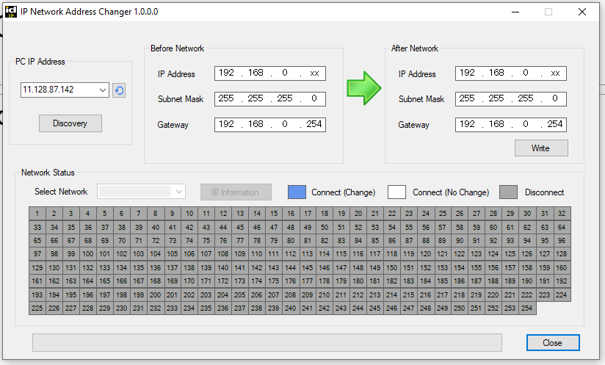
Step 1
Step 3
Step 2
Step 4

